Slide 1
Breast Cancer Detection
"Unleashing the Power of Autoencoders in Early Breast Cancer Identification"

Slide 2
Table of Contents
02
03
01
About the Project
About Breast Cancer
Dataset
04
05
Machine Learning
Conclusion
Developed a machine learning model for breast cancer detection, utilizing advanced algorithms to analyze medical data and enhance early diagnosis accuracy
Discuss about the breast cancer, types & characteristic
Represented the infographic & details of the dataset.
Methodology & Implementation of Machine learning model .
Summarization of whole context of the project.

Slide 3
Project Name:- Autoencoder based Disease Diagnosis System
Breast cancer was diagnosed in 2.3 million women, and around 685,000 deaths from breast cancer were recorded globally in 2020, making it the most common cancer. Early and accurate detection of breast cancer plays a critical role in improving the prognosis and bringing the patient survival rate to 50%. Deep learning-based computer-aided diagnosis (CAD) has achieved remarkable performance in early breast cancer diagnosis. This review focuses on literature considering deep learning architecture for breast cancer diagnosis. Therefore, this study anchors a well systematic and analytical review from six aspects: the model architecture of breast cancer diagnosis, datasets and image pre-processing, the manner of breast-cancer imaging, performance measurements, and research directions

Slide 4
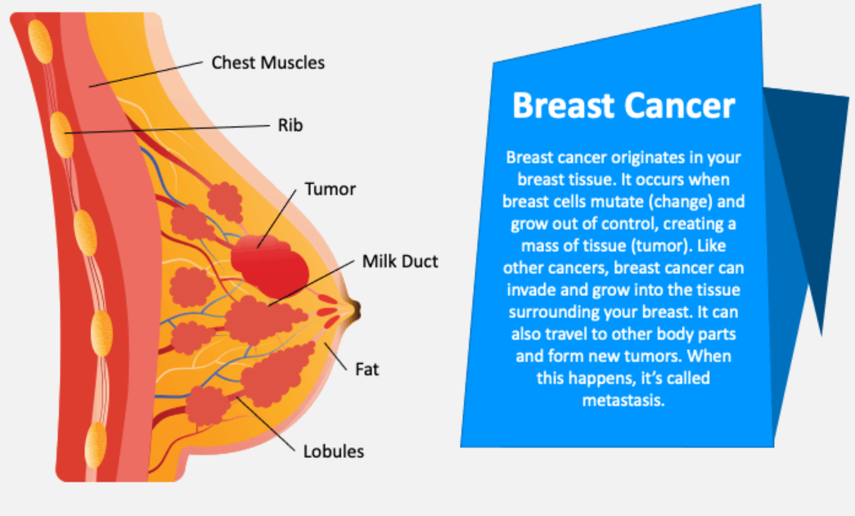
BREAST CANCER
What is Breast Cancer?

Slide 5
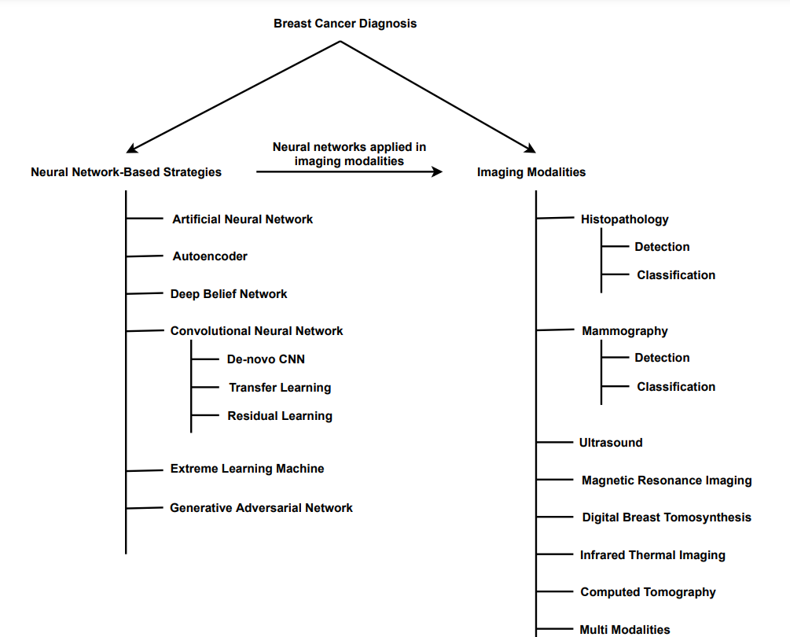
A taxonomy of deep-learning-based breast cancer diagnosis

Slide 6
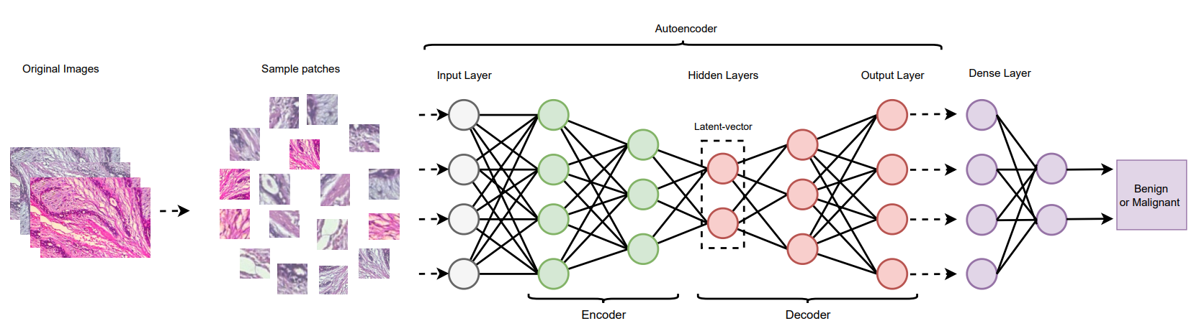
An illustration of the autoencoder model for breast-cancer diagnosis.

Slide 7
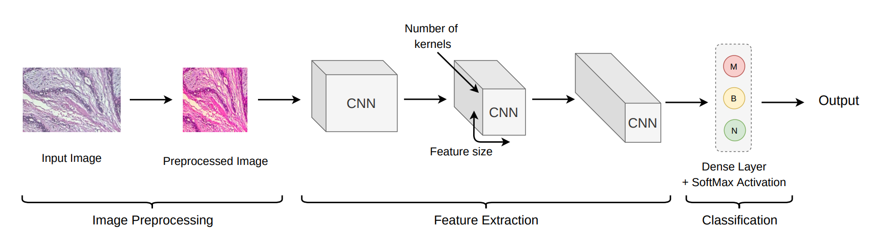
An illustration of CNN-based model for breast cancer diagnosis.

Slide 8
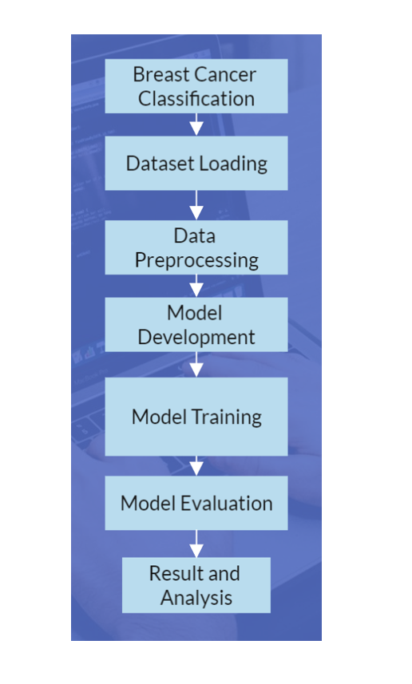

Slide 9
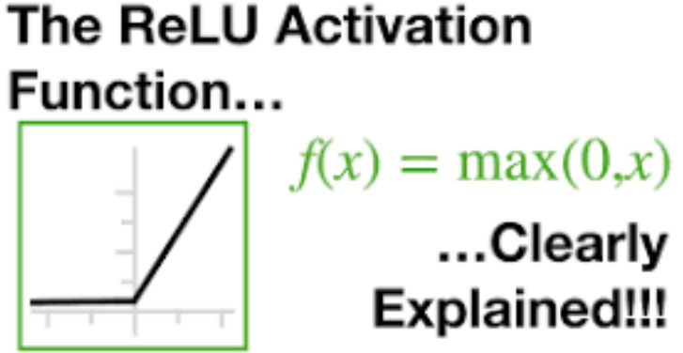
Why Is ReLU a Good Activation Function?
Help a model account for non-linear effects. This just means that if I graph a variable on the horizontal axis, and my predictions on the vertical axis, it isn't a straight line. Or said another way, the effect of increasing the predictor by one is different at different values of that predictor.
A function is non-linear if the slope isn't constant. So, the ReLU function is non-linear around 0, but the slope is always either 0 (for negative values) or 1 (for positive values). That's a very limited type of non-linearity.

Slide 10
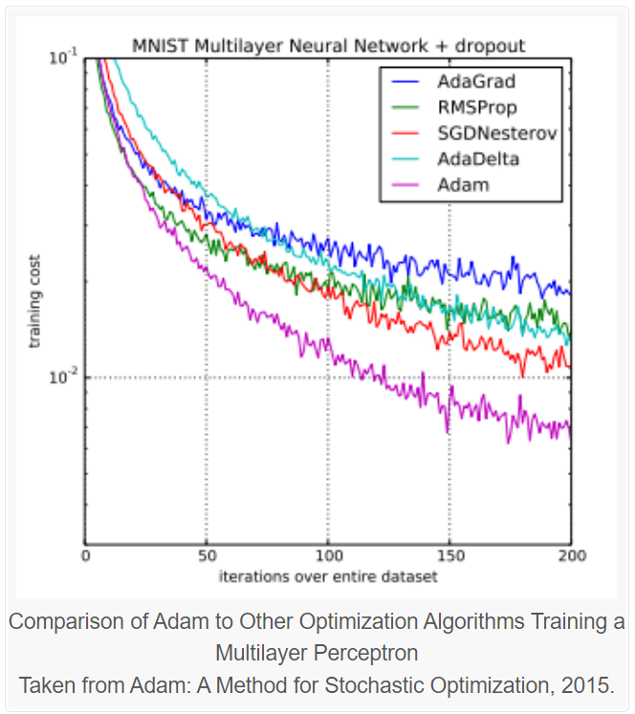
Adam Optimizer
Adam is a popular algorithm in the field of deep learning because it achieves good results fast.
Adam adjusts learning rates individually for each parameter, allowing for efficient optimization and convergence, especially in complex loss landscapes.
It uses the squared gradients to scale the learning rate like RMSprop, and it takes advantage of momentum by using the moving average of the gradient instead of the gradient itself, like SGD with momentum. This combines Dynamic Learning Rate and Smoothening to reach the global minima.

Slide 11
Conclusion
In this project, we proposed a methodology to develop a breast cancer classification system using Convolutional Neural Networks (CNNs). The dataset containing histopathological images of breast tissue was loaded and preprocessed to prepare it for model training. The dataset was divided into non-cancerous and cancerous images, and a subset of the data was selected to create a balanced dataset.
We developed a CNN model with multiple convolutional layers, max-pooling layers, batch normalization, and dropout layers to effectively extract features from the images. The model was trained using Adam optimizer with a learning rate of 0.0001 and monitored using an early stopping callback to prevent overfitting

Slide 12

A Picture Is Worth a Thousand Words

